Slide 1
Emergic Approach: Philosophy Applied to Cognition
Towards Unity
Notes:
Presentation look and feel adapted from the “Brain” Microsoft Office Online template.
How philosophy can be applied to unite all things mental (including itself & Cognitive Science)

Slide 2
Agenda
I hope they don’t ask difficult questions.
Time (pm) | Slides | Item
1:00 | 3-14 | Prologue
 | 16-17 | Research Problems
 | 18 | Answers
 | 19-24 | Philosophy & Metaphors
 | 25 | Hypotheses
 | 26-32 | Solution: Emergic Approach
 | 33 | Lilac Chaser Illusion
 | 34-35 | Lilac Chaser Model
2:30 | 36 | Discussion (@Mikes?)
Please do ask questions
Notes:
Please do ask questions
I may have too much to cover
I may skip parts and talk quickly.
Slow me down and ask questions as required, especially if you see something that catches your eye.
Lengthy discussions will be postponed for Mike’s

Slide 3
Prologue
Setting the mental scene

Slide 4
Act I
“vision science is not just one branch of cognitive science, but the single most coherent, integrated, and successful branch of cognitive science.” – Palmer, S. E. (1999). Vision Science: Photons to Phenomenology

Slide 5
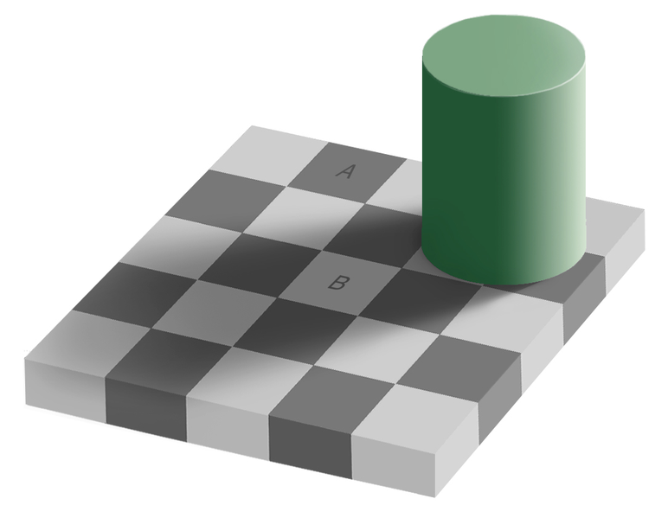
Colour Constancy (1)
Square A darker than square B.
Notes:
http://en.wikipedia.org/wiki/Same_color_illusion

Slide 6
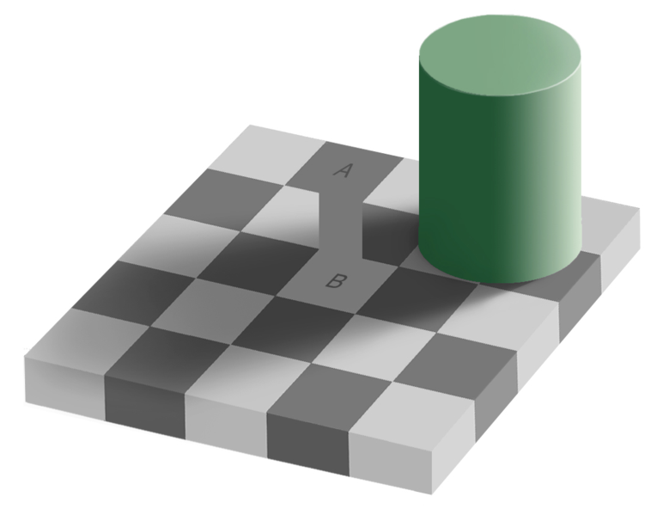
Colour Constancy (2)
A==B !
Notes:
http://en.wikipedia.org/wiki/Same_color_illusion

Slide 7
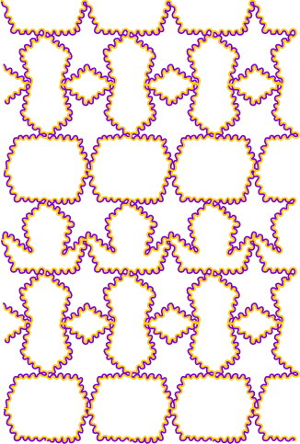
Colour Spreading
Insides of all are white
Notes:
http://www.scholarpedia.org/article/Watercolor_illusion

Slide 8
Act II
“However, the mechanism of brightness induction evident in several optical illusions, is not yet understood even after 200 years of intense research that saw George Berkeley, Maxwell, Helmholtz and the modern Gestalt school, that include both the intrinsic image theorists as well as the anchoring model theorists, following the “top-down” approach on one hand and Weber, Fechner, Mach, succeeded by the modern contrast theorists following the “bottom-up” approach on the other.” – Ghosh, K., & Bhaumik, K. (2010). Complexity in Human Perception of Brightness: A Historical Review on the Evolution of the Philosophy of Visual Perception. Journal of Biological Sciences, 10(1), 17-35
Notes:
And all other mental phenomena
I’ve become extremely appreciative of history

Slide 9
Diagnosis
Much neurobiological knowledge accumulated
Much behavioural (phenomenological) knowledge accumulated
Plethora of mental wisdom (hypotheticals) exponentially accumulates (poor S/N)
Zero mental knowledge accumulated
Not Integrated
Not Coherent
No Success
Challenge: find 1 fact about mental 90% accepted

Slide 10
Prognosis
Normal means of science might not suffice
No microscope on the non-physical “mental”
Microscope: Four Humours → Microbiology
Prism/Particle Accelerator: Chemistry → Quantum Mechanics
Telescope: Astrology → Astronomy
Nil: Temperaments → Psychoanalytics → …
Introspection Unreliability
Brain microscope (fMRI, EEG, Patch clamps)
Poor spatiotemporal resolution
Default network always active
Inter/Intra Subject Variation
Outward Behaviour vs. Inner Explanation
Emergent behaviour (also non-physical like mental)
Epicycles vs. Equations of Gravity/Motion
Glider, breeder, oscillator, spaceship, … (shadows?) vs. Game of Life
Notes:
Conway’s Game of Life can function as a Universal Turing Machine

Slide 11
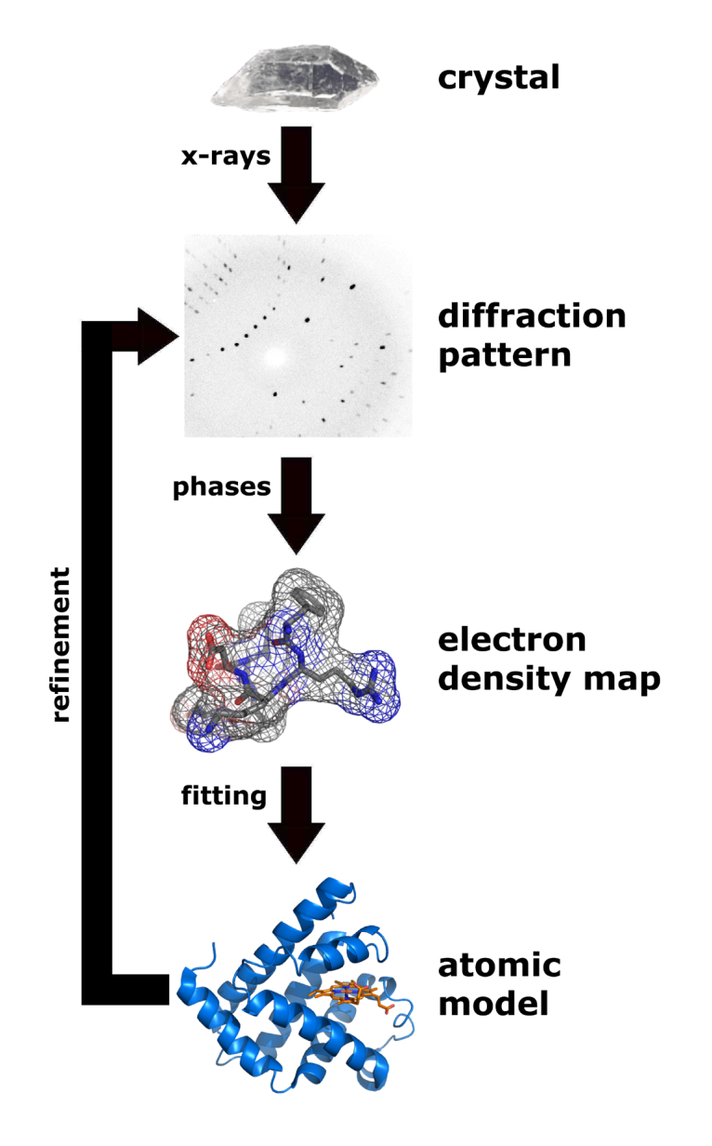
Variation - Physics
X-ray Crystallography
Techniques
Powder Diffraction
Goniometer
Crystals pure
Perfect diffraction Pattern
Each part identical to another
Each part consistent over time
This is a paradigm for all empirical work
Notes:
Credits
http://en.wikipedia.org/wiki/File:X_ray_diffraction.png
http://en.wikipedia.org/wiki/File:Kappa_goniometer_animation.ogg

Slide 12
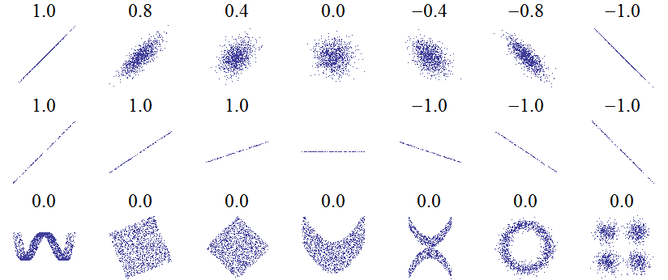
Prediction Accuracy
Precision of QED
fine structure constant, α → 10⁻⁸ sigs
Psychology
P-value significance: (every 20th theory is wrong!) <.05, <.01 (chance of false positive)
Pearson correlation:
|r²| > 0.3 → Medium
|r²| > 0.5 → Large
Wikipedia: “A correlation of 0.9 may be very low if one is verifying a physical law using high-quality instruments, but may be regarded as very high in the social sciences where there may be a greater contribution from complicating factors”
Notes:
Given enough samples, almost anything can be highly significant no matter how far removed from the causal chain (a small effect size).
Moreover, statistics do not imply causation.
For example, nose-pickers may be more shy (or is it popular kids more concerned about not doing things like picking noses). In any case, there is a long causal chain from one behaviour to another over long courses of time

Slide 13
Result
Lots of overly simplistic theories that apply to a limited domain
“Surrogates for Theories” - Gigerenzer, G. (2009). Surrogates for Theory. APS Observer, 22(2), 2-3.
Incommensurable theories
Cannot build up more powerful explanatory theories
Even among the various models of the same researcher and even when using cognitive architectures such as ACT-R

Slide 14
Treatment – Unify
“The first suggestion is to construct complete processing models rather than the partial ones we now do.” – Newell, A. (1973). You Can't Play 20 Questions with Nature and Win: Projective Comments on the Papers of this Symposium. In W. G. Chase, Visual Information Processing: Proceedings of the 8th Symposium on Cognition.
Unfortunately, these have not been forthcoming.
(I convert software control flow to hardware flow)

Slide 15
Unity – Classical Non-Empirical
Time | Psychology – Behaviour | Medicine - Symptom | Physics - Property
 | Temperament (=Myers-Briggs) | Humour | Element
Spring | Sanguine, Artisan Aspire, Inspire, Extrovert, Sensitive, Compassionate, Thoughtful, Forgetful | Blood Courageous, Hopeful, Amorous | Air Hot & Wet Power, Spirit
Summer | Choleric, Idealist Energy, Ambition, Assertive, Passion, Lead | Yellow Bile Easily Angered, Bad Tempered | Fire Hot & Dry
Autumn | Melancholic, Guardian Thoughtful, Considerate, Worried, Perfectionist, Independent, Focused | Black Bile Despondent, Sleepless, Irritable | Earth Cold & Dry Heaviness, Matter, Fertility
Winter | Phlegmatic, Rational Content, Kind, Accepting, Affectionate, Receptive, Shy, Stable, Relaxed | Phlegm Calm, Unemotional | Water Cold & Wet
Timeless | Divine, Unchanging, Pure |  | Aether, Space Clear, Essence
Notes:
Credits: Wikipedia
Temperaments of yesterday are the Myers-Briggs of today.
Unification alone cannot suffice
DSM: http://en.wikipedia.org/wiki/Diagnostic_and_Statistical_Manual_of_Mental_Disorders

Slide 16
Research

Slide 17
Research Problems
P1) What obstacles prevent the modelling of unified cognitive systems beyond a certain set of interactions?
P2) What are some viable solutions?

Slide 18
Answer P1: Recursion
Brain Modelling
Mostly Bottom-Up (with top-down modulation)
Stimulus-Response
Response reacted (reflex)
Mental Modelling
Mostly Top-Down (with bottom-up modulation)
Intentional: Goal Oriented
Stimuli pulled (read)
Behaviour Modelling
Stimulus-Response (controlled)
Previous behaviours affect subsequent ones
Cybernetic (control theory)
Perception
Top
A
A1
A2
B
B1
B2
Stimuli - Pushed
Intention
Top
A
A1
A2
B
B1
B2
Stimuli - Pulled

Slide 19
Recursion & Philosophy
Current “substance” philosophy cannot handle recursion
“This sentence is false.” ← True or False?
Gödel's incompleteness theorems
Tarski's semantic theory of truth
Zeno’s Paradoxes of Motion & Time
Recursion highlights that continuous change cannot be analytically broken up into discrete steps/values. Requires an infinity of steps and infinitesimally small values.
Identity and Change
Heap of Sand – arbitrariness of definitions; DSM
Ship of Theseus
Are you the same person today as after, losing an arm, being tortured?
Need a Process Philosophy

Slide 20
Metaphors as Guides
Metaphors guide our construction or deconstruction activities. E.g.,
Unstructured code → Structured → Functional → Object Oriented
The more disciplined and explicit understanding of our ontology, the better the result
Lots of incompatibilities in cognition (function, computation, cause, representation); too many fallacies
Remove bad metaphors (top-down, stimulus-response) and add better ones (interactive processes)
These are philosophic, metaphysical, and are about inducing theories rather than about specific theories

Slide 21
Metaphors & Wisdom
Keep it simple stupid. (KISS Principle)
Nothing is ever as simple as it seems. (Murphy’s Law #2)
Knowledge vs. Wisdom
Analytic - 1 possible outcome; “truth”
Mystic - 2+ possible outcomes; experience
Empiricism, Hardware & Software Engineering are mystic enterprises and currently not deducible
Keep our jobs!
Lots of wisdom about mental, simply no knowledge of mental
Notes:
Quotes
KISS: Clarence Johnson
Edward A. Murphy, Jr.
Duelling metaphors indicate mysticism

Slide 22
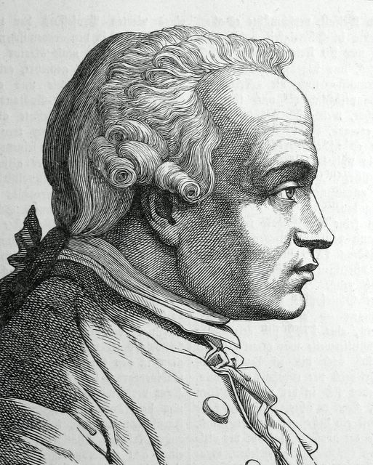
Metaphysics Frustrations
Metaphysics is a dark ocean without shores or lighthouse, strewn with many a philosophic wreck. – Immanuel Kant
Of course, what philosophers say about metaphysics, many can say about philosophy!
Notes:
Portrait:
From: http://portrait.kaar.at/200Deutsche3/image21.html
Title: (Translated from German) portrait of Immanuel Kant comes from the book "Two hundred German men", published by Ludwig Bechstein, Leipzig the 1854th
Kant didn’t actually say that metaphysics is useless, just that it has yet bear fruit. ???

Slide 23
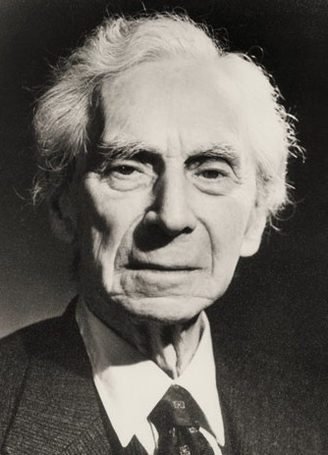
Philosophy Frustrations
The point of philosophy is to start with something so simple as not to seem worth stating, and to end with something so paradoxical that no one will believe it.
– Bertrand Russell (1872 - 1970), The Philosophy of Logical Atomism
Notes:
I don’t agree with Russell’s view but am equally frustrated.
As long as each type of analysis is based on crisp black & white substances (conceptions) then paradoxes must result proving black & white wrong.
Process metaphysics will end this state-of-affairs.
Portrait:
From: http://www.qcms.org/Fun%20Facts.htm

Slide 24
Metaphysics - History
~500 BC Process Metaphysics lost out to Substance Metaphysics
Due to bad timing (poor mathematical tools)
Buddhism took on mystic
~1900 AD Physics implicitly rewrote metaphysics for themselves with great success
Huge foundation of Substance Philosophy to overcome
Philosophy of Cognition and Cognitive Science are still thrashing
Is it time to put physics explicitly back into metaphysics?

Slide 25
Answer P2: Hypotheses
H1: The Emergic Approach (EA) can help induce unified theories of cognition, especially in highly recursive systems such as the brain
Mostly mystic philosophic advice geared toward cognitive induction – not a cognitive theory
First? Analytic process metaphysics
H2: The Lilac Chaser Model (LCM) demonstrates H1
Proof by empiricism, not rationalism
All design choices here constitute our cognitive theory

Slide 26
Emergic Approach
Harnessing Change

Slide 27
Heraclitus (535-475 BC)
Father of Process Metaphysics/Philosophy
Aphorisms
“Everything is in a state of flux”
“The only constant is change”
“All things are one”
All things change at the same time and affect each other
Unity of opposites
Equilibrium
Completely mystic
Notes:
Lead to Plato’s changeless metaphysics
(quoted in Hippolytus, Refutations ) The unapparent connection is more powerful than the apparent one.
http://www.utm.edu/research/iep/h/heraclit.htm

Slide 28
EA Summary
Emergic Metaphysics | Process philosophy adopting change interactions as a unifying metaphor
Emergic Networks | Analytic brain simulation of above as Lego™ bricks of change
Emergic Design Principles | Unify, Bottom-Up Re-Engineering, Bottom-Up/Top-Down/Lateral interactions, Model deep structure not surface phenomena via simplify globally but complexify locally, i.e., many phenomena by fewer interactions – “emergic”, cognitive plausibility
Emergic Vision System | Manage world/brain interaction where we place our Lilac Chaser Model

Slide 29
Process Metaphysics – Simple Process Example
A simple observed process is analytic and formulated as
“A becomes of –A/2” or A += -A/2 or (1)
The change operator (“+=”)
Usually small snippets of functional code rather than “+=”
Example could produce the sequence {1, ½, ¼, ... 1/2^{n}} every ∆t
This could represent a battery becoming discharged
Note: non-linear exponential behaviour emerges despite being simply a linear sum of parts. This is due to recursion.
Process eventually must have self-reference (recursion)
Allows it to change over time even if stimuli removed
(This is explicitly not allowed in Causal Bayesian Networks)
-½
A

Slide 30
Process Metaphysics – Simple Process Ensemble
All processes in a system interact continuously and are shown in an ensemble. Here is the Lotka–Volterra predator-prey example
Rabbit += (α*Rabbit) – (β*Rabbit*Fox)
Fox += – (γ*Fox) + (δ*Rabbit*Fox)
The Rabbit*Fox term is not recursive, is not independent, has no observable reality and is simply shown for simplicity
Represents the chance that fox and rabbits will meet
Has no delays
RHS influence LHS often
Interactively
Terms of Opposition (+ vs. -)
System is time invariant
Rabbit * Fox
1
1
- β
+ δ
Rabbit +=
Fox +=
+α
- γ

Slide 31
Interaction
When two particles collide, they interact.
Informationally, this can be shown as
In practice, “+=” is conceptual and replaced with short functional code segments
A
Ai
Short Code for Ao = … Bo = …
Ao
B
Bo
Bi

Slide 32
Process Network Example
Automatically generates missing info
blink
Optical blind spot
Continuous Interaction
Bottom-up
Top-down
Incremental Learning of Dynamics
Not solution
No substance (weights)
Adaptive
Incremental Levels
Improve accuracy
No Delay
8 Spreadsheet Columns
Delay
Need Network
+Efferents
Far Predictors
Not needed
dPrv
dNow
dErr
dF_{3,2}=2
dF_{3,1}=5
dF_{3,0}=14
pF_{3,1}=42
pF_{3,2}=90
pF_{3,3}=165
Level 3
t-7
t-6
t-5
vPrv
vNow
vNxt
dPrv
dNow
dErr
dF_{2,1}=2
dF_{2,0}=5
pF_{2,1}=14
pF_{2,2}=28
pF_{2,3}=48
Level 2
t-5
t-4
t-3
vPrv
vNow
vNxt
Level 1
dPrv
dNow
dErr
dF_{1,0}=2
pF_{1,1}=5
pF_{1,2}=9
pF_{1,3}=14
Detectons/Changeons
t-3
t-2
t-1
vPrv
vNow
vNxt
dPrv
dNow
dErr
pF_{0,1}=2
pF_{0,2}=3
pF_{0,3}=4
Level 0
t-1
t
t+1
vPrv
vNow
vNxt
f(t) = at³ + bt² +ct + d
Value In(t)
dNow
dNow
dNow
Predictons
t+2
t+3
t+4
vNxt
vNxt
vNxt
Level 1
Level 2
Level 3
Prediction Out(t+1)

Slide 33
Lilac Chaser Illusion
Standard Explanation
Perception of motion due to beta movement
Troxler’s fading
Negative afterimage is due to neural adaptation and colour opponent processing
Notes:
http://en.wikipedia.org/wiki/Lilac_chaser

Slide 34
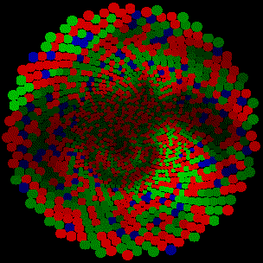
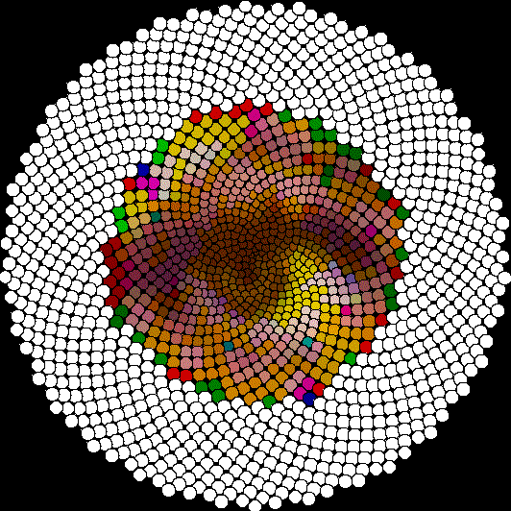
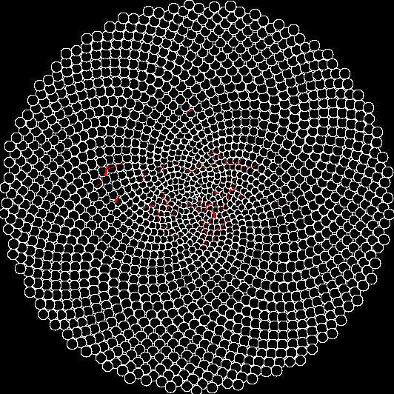
Demonstrate LCM Simulation
Jittering on Lena’s eye
Photoreceptor Level
Two Pathways
Spatial Summation
Change detection

Slide 35
LCM Model Motor Planning
Planning System
Legend:
I: Input
O: Output
U: Up
D: Down
IDShift
OUShift
Planner
ODShift
IUShift
Pyramid
IDShift
OUShift
IDShift
OUShift
Distributor
RF Layer 3
ODShift
IUShift
ODShift
IUShift
IDShift
OUShift
Distributor
IDShift
OUShift
IDShift
OUShift
Lateral value movement not shown
RF Layer 2
RF Layer 2
ODShift
IUShift
ODShift
IUShift
ODShift
IUShift
IDShift
OUShift
Distributor
IDShift
OUShif
RF 1
IDShift
OUShif
IDShift
OUShif
RF 1
RF 1
IDShift
OUShif
RF 1
ODShift
IUShift
ODShif
2
IUShift
ODShif
2
IUShift
ODShif
2
IUShift
ODShif
IUShift
2
IDShift
OUShift
Executor
ODShift
IUShift
Photoreceptors

Slide 36
Q & A
Mikes?

